Slide 1
CS246: Linear Transformation
Junghoo “John” Cho
UCLA

Slide 2
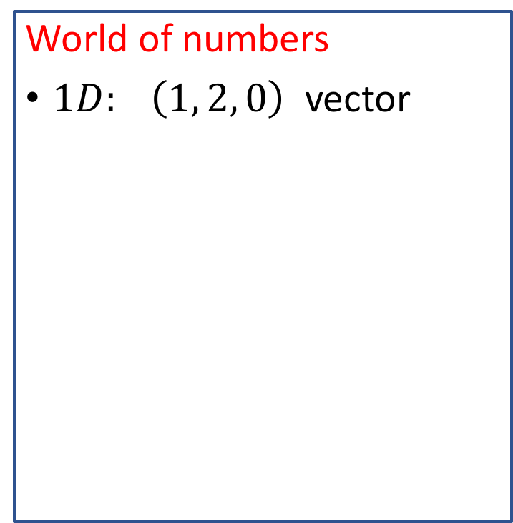
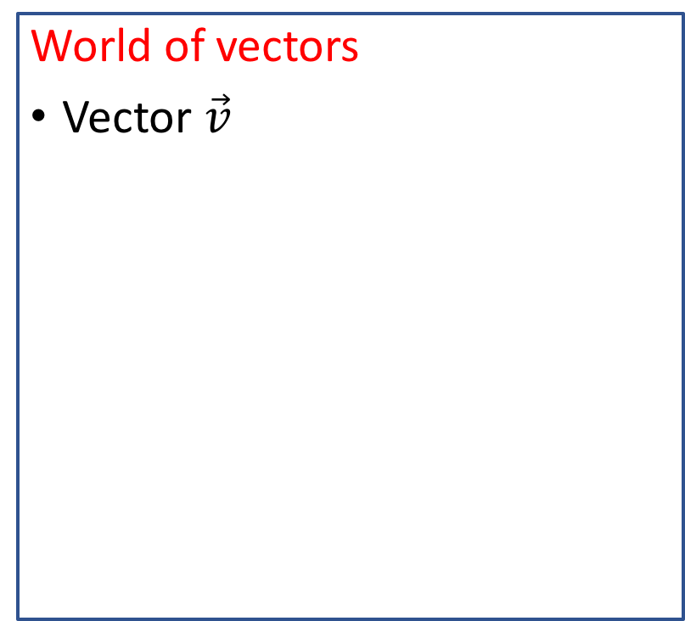
Where We Are: Two Worlds
World of vectors
Vector $\vec{v}$
World of numbers
$1D: \left(1, 2, 0\right)$ vector
1:1 mapping (=isomorphic)
basis vectors
4
5
3

Slide 3
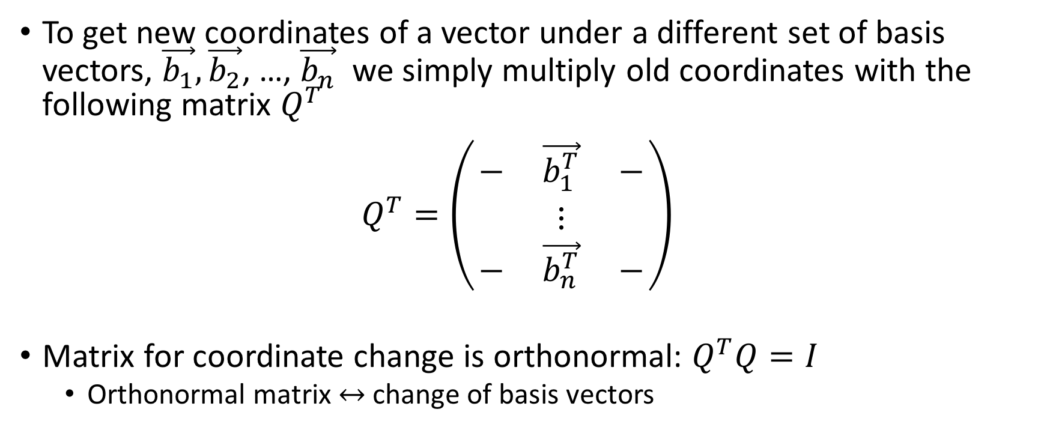
Change of Coordinates as Matrix Multiplication
To get new coordinates of a vector under a different set of basis vectors, $\vec{b_{1}},\vec{b_{2}}$, …, $\vec{b_{n}}$ we simply multiply old coordinates with the following matrix $Q^{T}$
$Q^{T}=\left(\begin{matrix}− & \vec{b_{1}^{T}} & − \\ & ⋮ & \\ − & \vec{b_{n}^{T}} & −\end{matrix}\right)$
Matrix for coordinate change is orthonormal: $Q^{T}Q=I$
  Orthonormal matrix $↔$ change of basis vectors

Slide 4


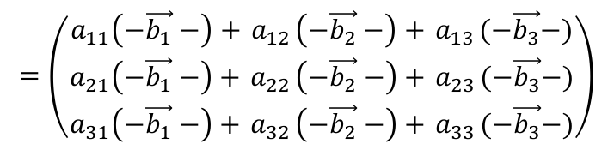
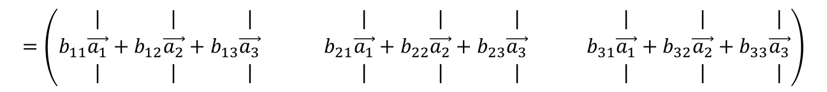
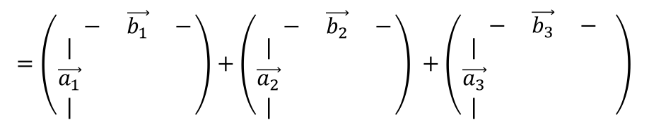
Matrix Multiplication: “Vector Array” View
$$=\left(\begin{matrix}a_{11}\left(−\vec{b_{1}}−\right)+{ a}_{12}\left(−\vec{b_{2}}−\right)+{ a}_{13}(−\vec{b_{3}}−) \\ a_{21}\left(−\vec{b_{1}}−\right)+{ a}_{22}\left(−\vec{b_{2}}−\right)+{ a}_{23}(−\vec{b_{3}}−) \\ a_{31}\left(−\vec{b_{1}}−\right)+{ a}_{32}\left(−\vec{b_{2}}−\right)+{ a}_{33}(−\vec{b_{3}}−)\end{matrix}\right)$$
$\left(\begin{matrix}− & \vec{a_{1}} & − \\ − & \vec{a_{2}} & − \\ − & \vec{a_{3}} & −\end{matrix}\right)$ $\left(\begin{matrix}− & \vec{b_{1}} & − \\ − & \vec{b_{2}} & − \\ − & \vec{b_{3}} & −\end{matrix}\right)$
$\left(\begin{matrix}− & \vec{a_{1}} & − \\ − & \vec{a_{2}} & − \\ − & \vec{a_{3}} & −\end{matrix}\right)$ $\left(\begin{matrix}| & | & | \\ \vec{b_{1}} & \vec{b_{2}} & \vec{b_{3}} \\ | & | & |\end{matrix}\right)$
$\left(\begin{matrix}| & | & | \\ \vec{a_{1}} & \vec{a_{2}} & \vec{a_{3}} \\ | & | & |\end{matrix}\right)\left(\begin{matrix}− & \vec{b_{1}} & − \\ − & \vec{b_{2}} & − \\ − & \vec{b_{3}} & −\end{matrix}\right)$
$\left(\begin{matrix}| & | & | \\ \vec{a_{1}} & \vec{a_{2}} & \vec{a_{3}} \\ | & | & |\end{matrix}\right)$ $\left(\begin{matrix}| & | & | \\ \vec{b_{1}} & \vec{b_{2}} & \vec{b_{3}} \\ | & | & |\end{matrix}\right)$
$$=\left(\begin{matrix}⋮ & ⋮ & ⋮ \\ ⋮ & a_{ij}=\vec{a_{i}}∙\vec{b_{j}} & ⋮ \\ ⋮ & ⋮ & ⋮\end{matrix}\right)$$
$$=\left(\begin{matrix} \\ | \\ \vec{a_{1}} \\ |\end{matrix}\begin{matrix}− & \vec{b_{1}} & − \\ & & \\ & & \\ & & \end{matrix}\right)+\left(\begin{matrix} \\ | \\ \vec{a_{2}} \\ |\end{matrix}\begin{matrix}− & \vec{b_{2}} & − \\ & & \\ & & \\ & & \end{matrix}\right) +\left(\begin{matrix} \\ | \\ \vec{a_{3}} \\ |\end{matrix}\begin{matrix}− & \vec{b_{3}} & − \\ & & \\ & & \\ & & \end{matrix} \right)$$
$$=\left(\begin{matrix}b_{11}\begin{matrix}| \\ \vec{a_{1}} \\ |\end{matrix}+b_{12}\begin{matrix}| \\ \vec{a_{2}} \\ |\end{matrix}+b_{13}\begin{matrix}| \\ \vec{a_{3}} \\ |\end{matrix} & b_{21}\begin{matrix}| \\ \vec{a_{1}} \\ |\end{matrix}+b_{22}\begin{matrix}| \\ \vec{a_{2}} \\ |\end{matrix}+b_{23}\begin{matrix}| \\ \vec{a_{3}} \\ |\end{matrix} & { b}_{31}\begin{matrix}| \\ \vec{a_{1}} \\ |\end{matrix}+b_{32}\begin{matrix}| \\ \vec{a_{2}} \\ |\end{matrix}+b_{33}\begin{matrix}| \\ \vec{a_{3}} \\ |\end{matrix}\end{matrix}\right)$$

Slide 5

Matrix Multiplication: Vector Transformation
Multiplying a matrix with a vector results in another vector
$\vec{v}=\left(\begin{matrix}1 \\ 1 \\ 0\end{matrix}\right), M=\left(\begin{matrix}2 & 0 & 1 \\ 1 & 1 & 3 \\ 0 & 2 & 2\end{matrix}\right) M\vec{v}=\left(\begin{matrix}2 & 0 & 1 \\ 1 & 1 & 3 \\ 0 & 2 & 2\end{matrix}\right)$ $\left(\begin{matrix}1 \\ 1 \\ 0\end{matrix}\right)=\left(\begin{matrix}2 \\ 2 \\ 2\end{matrix}\right)={\vec{v}}^{′}$
2
1
2
1
2

Slide 6
Matrix Multiplication: Vector Transformation
Q: What kinds of vector transformations are possible through matrix multiplication?
  Rotation? Stretching? Projection? Translation? Complex nonlinear transformation?
Topic of our next discussion

Slide 7
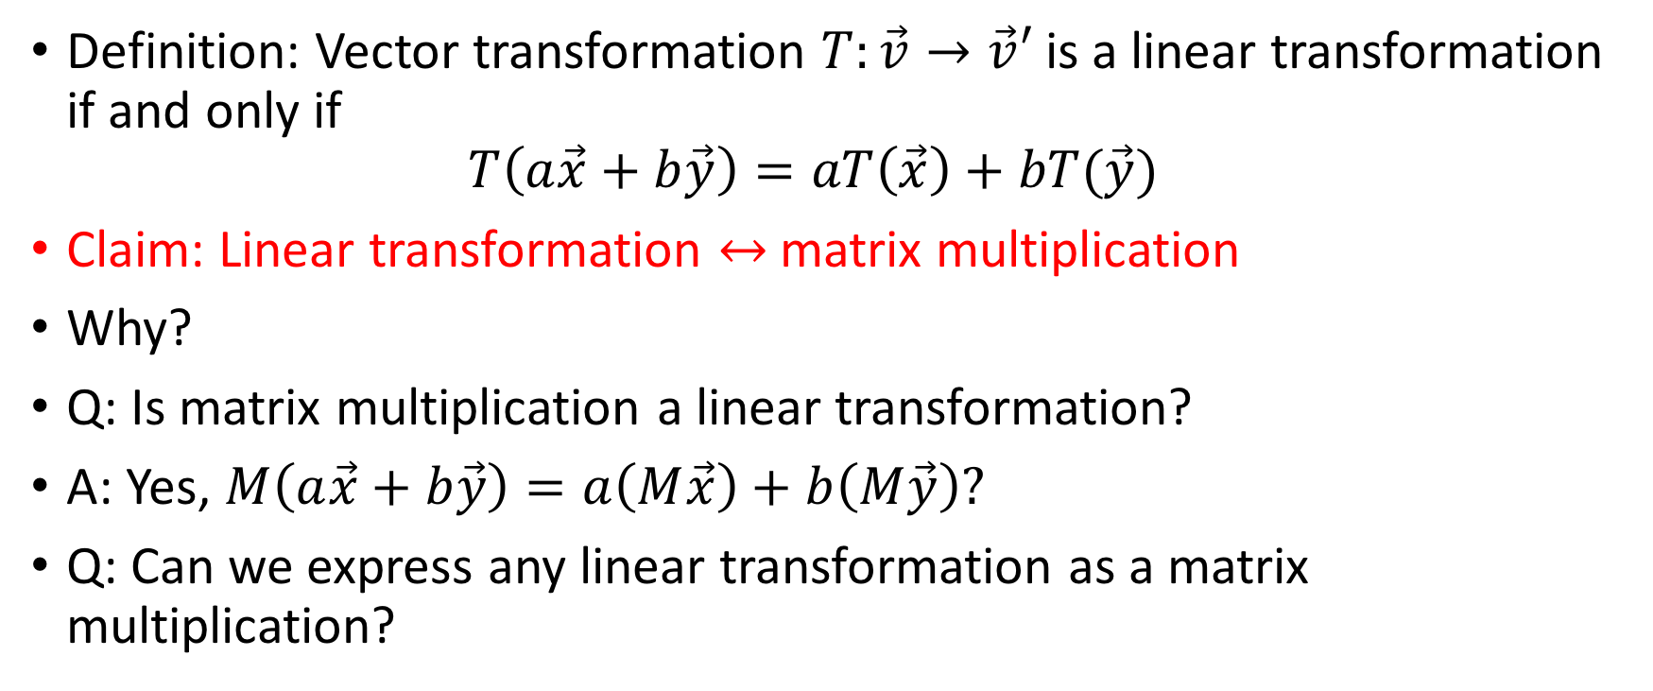
Linear Transformation
Definition: Vector transformation $T:\vec{v}→\vec{v}′$ is a linear transformation if and only if
$T\left(a\vec{x}+b\vec{y}\right)=aT\left(\vec{x}\right)+bT(\vec{y})$
Claim: Linear transformation $↔$matrix multiplication
Why?
Q: Is matrix multiplication a linear transformation?
A: Yes, $M\left(a\vec{x}+b\vec{y}\right)=a\left(M\vec{x}\right)+b\left(M\vec{y}\right)?$
Q: Can we express any linear transformation as a matrix multiplication?

Slide 8



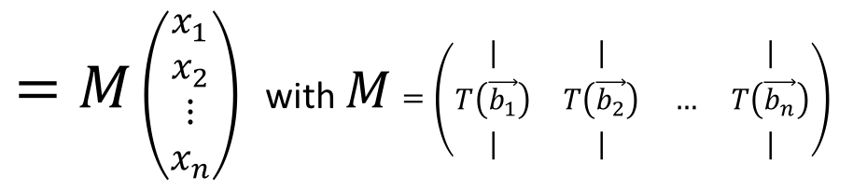

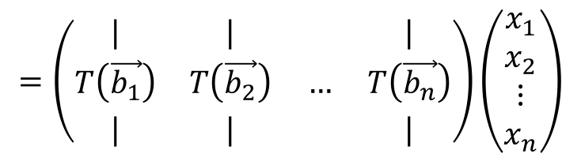
Linear Transformation to Matrix
Assume basis vectors: $\vec{b_{1}},\vec{b_{2}}$, …, $\vec{b_{n}}$
Given any vector$\vec{x}=\left(x_{1},x_{2}, …, x_{n}\right)=x_{1}\vec{b_{1}}+x_{2}\vec{b_{2}}+…+x_{n}\vec{b_{n}}$ and linear transformation $T(\vec{x})$
$$T\left(\vec{x}\right)$$
$$=T\left(x_{1}\vec{b_{1}}+x_{2}\vec{b_{2}}+…+x_{n}\vec{b_{n}}\right)$$
$$=x_{1}T\left(\vec{b_{1}}\right)+x_{2}T\left(\vec{b_{2}}\right)+…+x_{n}T\left(\vec{b_{n}}\right)$$
$$=\left(\begin{matrix}| & | & & | \\ T\left(\vec{b_{1}}\right) & T\left(\vec{b_{2}}\right) & … & T\left(\vec{b_{n}}\right) \\ | & | & & |\end{matrix}\right)\left(\begin{matrix}x_{1} \\ x_{2} \\ ⋮ \\ x_{n}\end{matrix}\right)$$
$=M$ $\left(\begin{matrix}x_{1} \\ x_{2} \\ ⋮ \\ x_{n}\end{matrix}\right)$ with $M$ $=\left(\begin{matrix}| & | & & | \\ T\left(\vec{b_{1}}\right) & T\left(\vec{b_{2}}\right) & … & T\left(\vec{b_{n}}\right) \\ | & | & & |\end{matrix}\right)$

Slide 9

Matrix Representation of Linear Transformation
Any linear transformation can be expressed as matrix $M$:
$M$ $=\left(\begin{matrix}| & | & & | \\ T\left(\vec{b_{1}}\right) & T\left(\vec{b_{2}}\right) & … & T\left(\vec{b_{n}}\right) \\ | & | & & |\end{matrix}\right)$
  Each column of $M$ is the the transformed basis vector $\vec{b_{i}}$

Slide 10
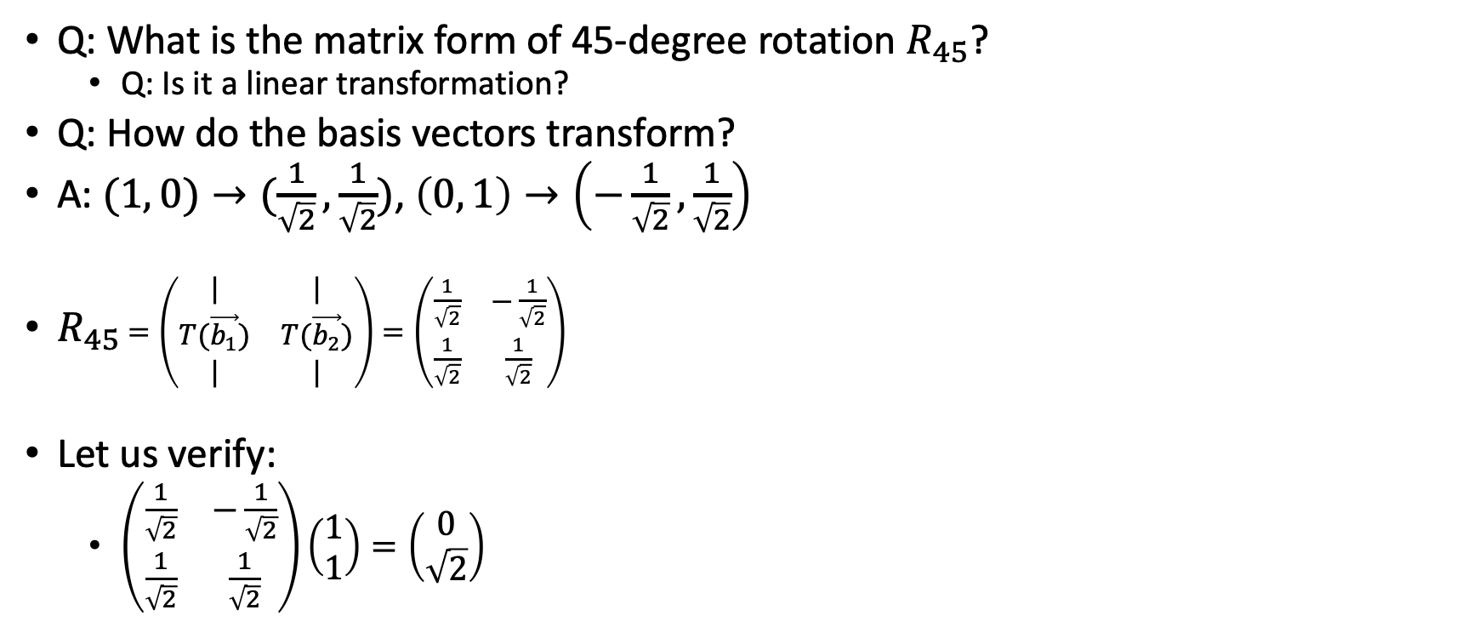
Example: Linear Transformation Matrix
(0, 1)
Q: What is the matrix form of 45-degree rotation $R_{45}$?
  Q: Is it a linear transformation?
Q: How do the basis vectors transform?
A: $(1, 0)→(\frac{1}{\sqrt{2}},\frac{1}{\sqrt{2}})$, $\left(0, 1\right)→\left(−\frac{1}{\sqrt{2}},\frac{1}{\sqrt{2}}\right)$
$R_{45}$ $=\left(\begin{matrix}| & | \\ T(\vec{b_{1}}) & T(\vec{b_{2}}) \\ | & |\end{matrix}\right)=\left(\begin{matrix}\frac{1}{\sqrt{2}} & −\frac{1}{\sqrt{2}} \\ \frac{1}{\sqrt{2}} & \frac{1}{\sqrt{2}}\end{matrix}\right)$
Let us verify:
  $\left(\begin{matrix}\frac{1}{\sqrt{2}} & −\frac{1}{\sqrt{2}} \\ \frac{1}{\sqrt{2}} & \frac{1}{\sqrt{2}}\end{matrix}\right)\left(\begin{matrix}1 \\ 1\end{matrix}\right)=\left(\begin{matrix}0 \\ \sqrt{2}\end{matrix}\right)$
(1, 0)

Slide 11
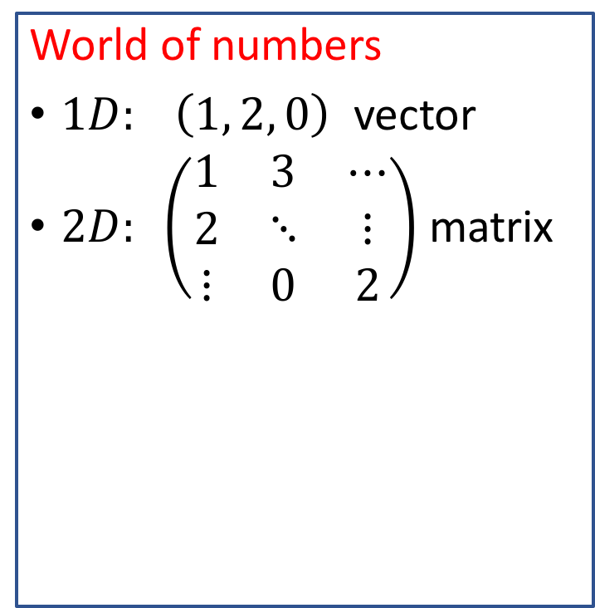
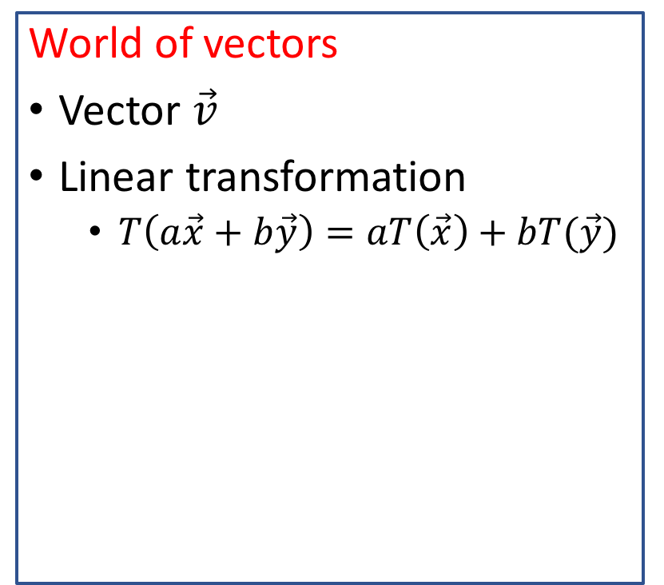
Where We Are: Two Worlds
World of vectors
Vector $\vec{v}$
Linear transformation
  $T\left(a\vec{x}+b\vec{y}\right)=aT\left(\vec{x}\right)+bT(\vec{y})$
World of numbers
$1D: \left(1, 2, 0\right)$ vector
$2D: \left(\begin{matrix}1 & 3 & ⋯ \\ 2 & ⋱ & ⋮ \\ ⋮ & 0 & 2\end{matrix}\right)$ matrix
1:1 mapping (=isomorphic)
basis vectors
4
5
3

Slide 12
Linear Transformation: What Are They?
Q: What transformations are possible under linear transformation?
  Rotation? Stretch? Shearing? Projection? Translation?
Bold claim: Every linear transformation is nothing more than “stretching” followed by “rotation”
  Is it really true? How can it be so simple? Is there really nothing more?
Singular value decomposition (SVD)
  A formal “proof” of the above statement
  A key result from linear algebra
  Topic of our next discussion

Slide 13

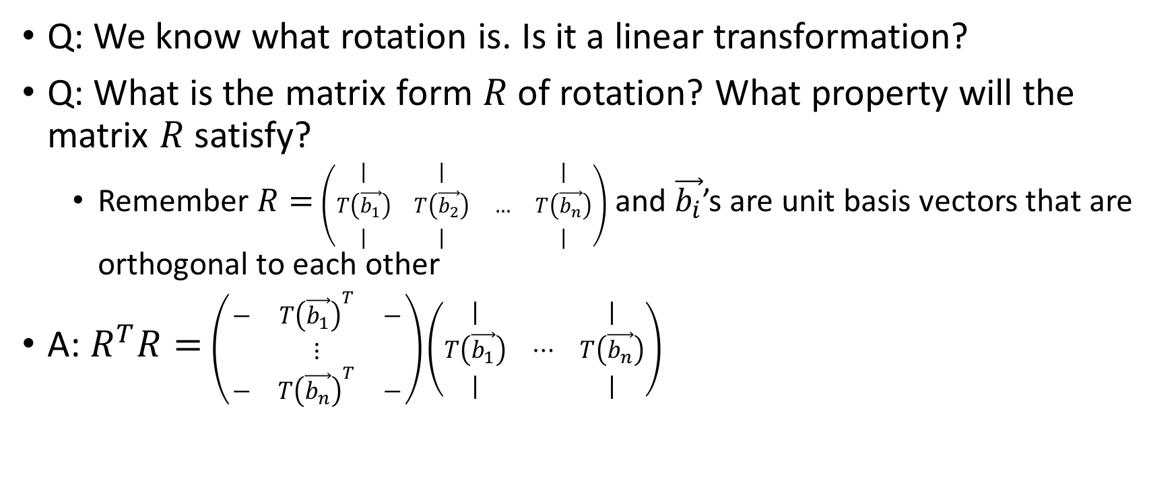
Linear Transformation: Rotation
Q: We know what rotation is. Is it a linear transformation?
Q: What is the matrix form $R$ of rotation? What property will the matrix $R$satisfy?
  Remember $R=$ $\left(\begin{matrix}| & | & & | \\ T\left(\vec{b_{1}}\right) & T\left(\vec{b_{2}}\right) & … & T\left(\vec{b_{n}}\right) \\ | & | & & |\end{matrix}\right)$ and $\vec{b_{i}}$’s are unit basis vectors that are orthogonal to each other
A: $R^{T}R=$ $\left(\begin{matrix}− & T{\left(\vec{b_{1}}\right)}^{T} & − \\ & ⋮ & \\ − & T{\left(\vec{b_{n}}\right)}^{T} & −\end{matrix}\right)\left(\begin{matrix}| & & | \\ T\left(\vec{b_{1}}\right) & ⋯ & T\left(\vec{b_{n}}\right) \\ | & & |\end{matrix}\right)$
$$=I$$

Slide 14


Rotation Matrix $R$
Rotation ${↔ R}^{T}R=I$(orthonormal matrix)
  assuming that rotation includes “reflection”
Two interpretations of orthonormal matrix
  Rotation (linear transformation)
  Matrix for change of coordinate system

Slide 15

Linear Transformation: Stretching
Q: We know what stretching is. Is it a linear transformation?
Q: What is the matrix form $S$ of a stretching? What property will the matrix $S$ satisfy?

Slide 16
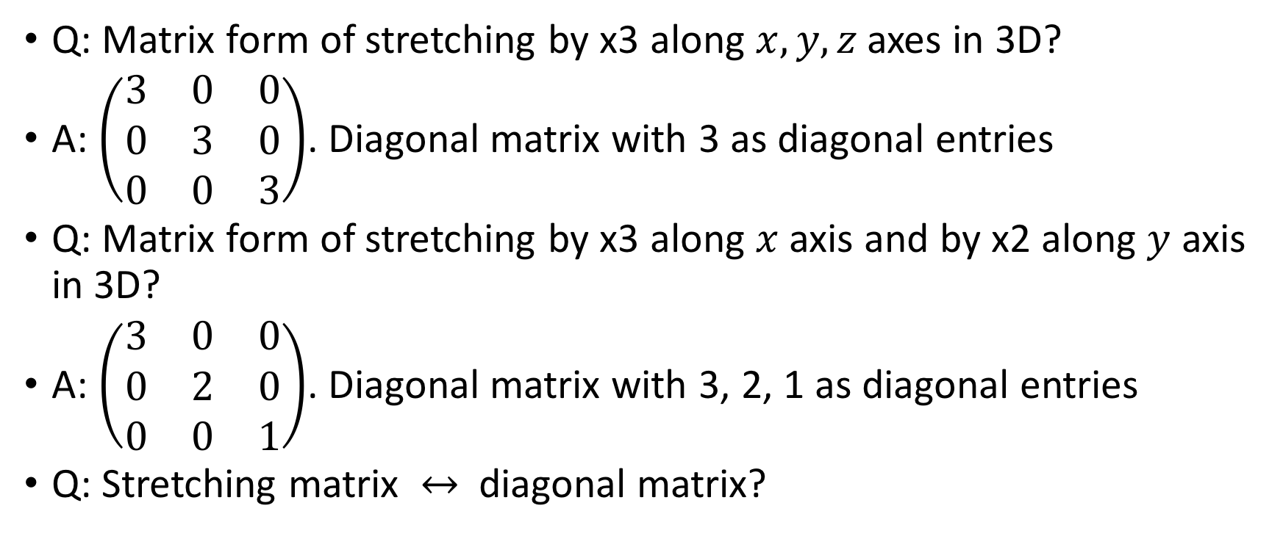
Example: Stretching (1)
Q: Matrix form of stretching by x3 along $x, y, z$ axes in 3D?
A: $\left(\begin{matrix}3 & 0 & 0 \\ 0 & 3 & 0 \\ 0 & 0 & 3\end{matrix}\right)$. Diagonal matrix with 3 as diagonal entries
Q: Matrix form of stretching by x3 along $x$ axis and by x2 along $y$ axis in 3D?
A: $\left(\begin{matrix}3 & 0 & 0 \\ 0 & 2 & 0 \\ 0 & 0 & 1\end{matrix}\right)$. Diagonal matrix with 3, 2, 1 as diagonal entries
Q: Stretching matrix $↔$ diagonal matrix?

Slide 17

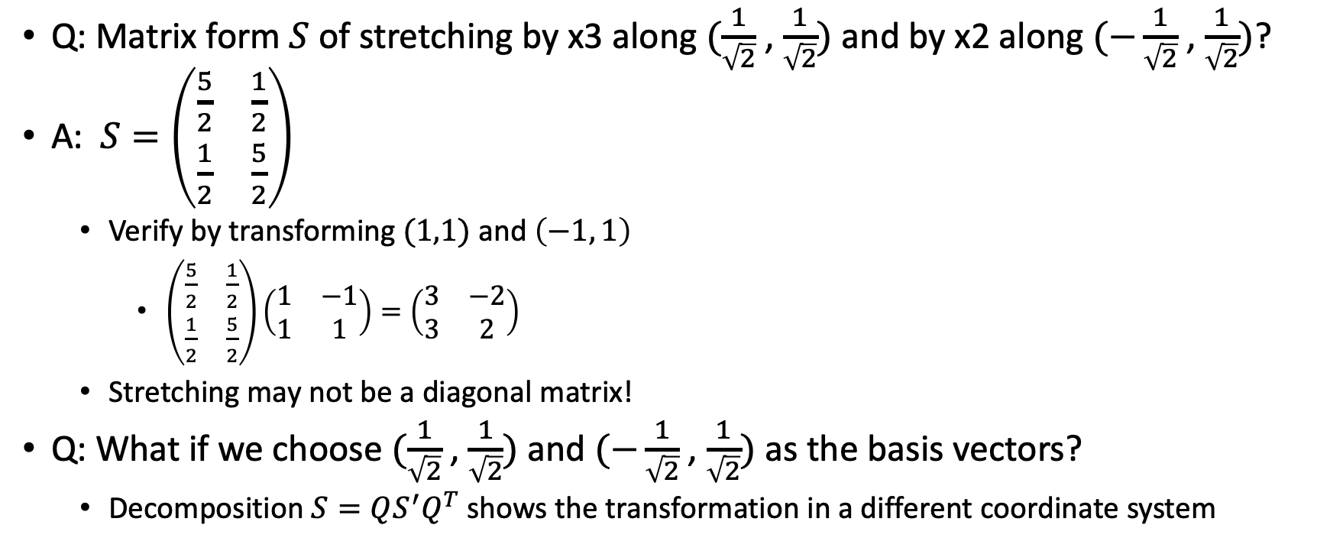
Example: Stretching (2)
  Q: Matrix form $S$ of stretching by x3 along $(\frac{1}{\sqrt{2}}$ , $\frac{1}{\sqrt{2}})$ and by x2 along $(−\frac{1}{\sqrt{2}}$ , $\frac{1}{\sqrt{2}})$?
  A:$S=\left(\begin{matrix}\frac{5}{2} & \frac{1}{2} \\ \frac{1}{2} & \frac{5}{2}\end{matrix}\right)$
    Verify by transforming $(1,1)$ and $\left(−1, 1\right)$
      $\left(\begin{matrix}\frac{5}{2} & \frac{1}{2} \\ \frac{1}{2} & \frac{5}{2}\end{matrix}\right)\left(\begin{matrix}1 & −1 \\ 1 & 1\end{matrix}\right)=\left(\begin{matrix}3 & −2 \\ 3 & 2\end{matrix}\right)$
    Stretching may not be a diagonal matrix!
  Q: What if we choose $(\frac{1}{\sqrt{2}}$ , $\frac{1}{\sqrt{2}})$ and $(−\frac{1}{\sqrt{2}}$ , $\frac{1}{\sqrt{2}})$ as the basis vectors?
    Decomposition $S=QS^{′}Q^{T}$ shows the transformation in a different coordinate system
$$=\left(\begin{matrix}\frac{1}{\sqrt{2}} & −\frac{1}{\sqrt{2}} \\ \frac{1}{\sqrt{2}} & \frac{1}{\sqrt{2}}\end{matrix}\right)\left(\begin{matrix}3 & 0 \\ 0 & 2\end{matrix}\right)\left(\begin{matrix}\frac{1}{\sqrt{2}} & \frac{1}{\sqrt{2}} \\ −\frac{1}{\sqrt{2}} & \frac{1}{\sqrt{2}}\end{matrix}\right)$$

Slide 18
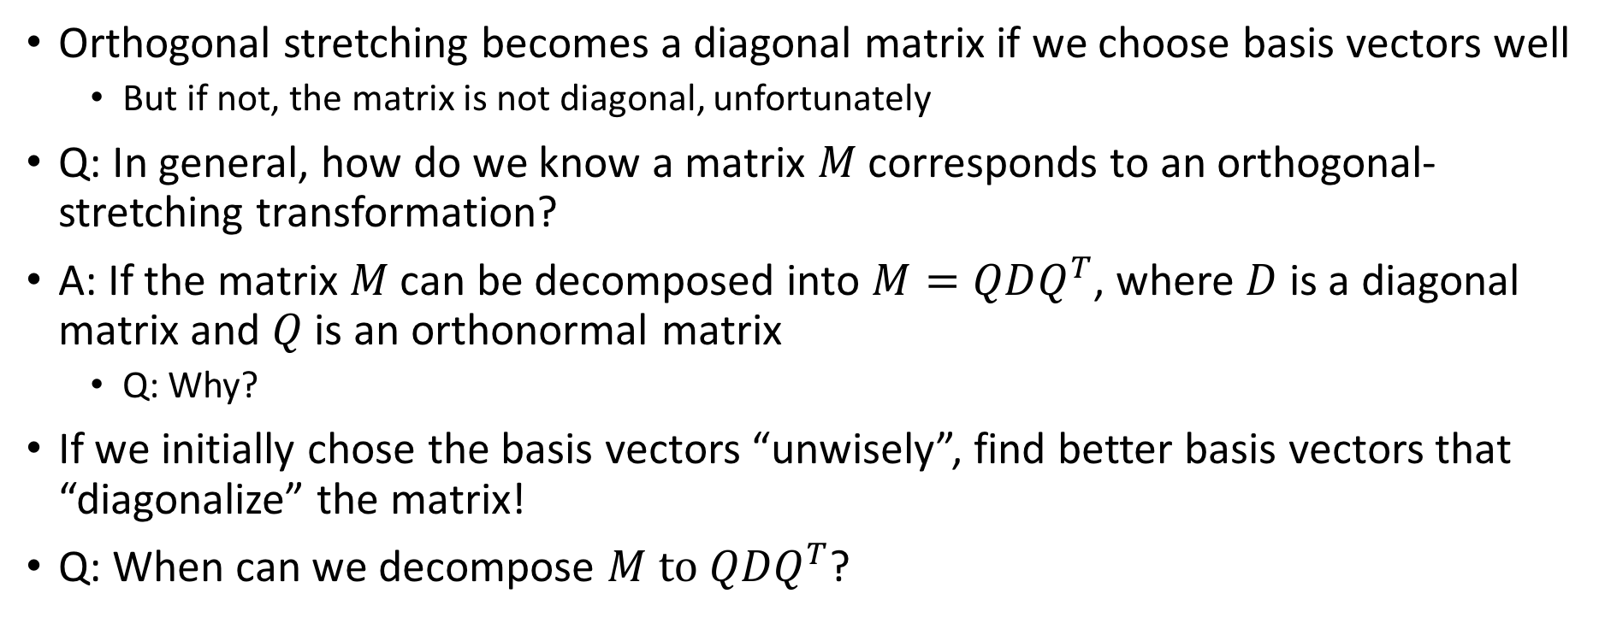
Orthogonal Stretching
Orthogonal stretching becomes a diagonal matrix if we choose basis vectors well
  But if not, the matrix is not diagonal, unfortunately
Q: In general, how do we know a matrix $M$corresponds to an orthogonal-stretching transformation?
A: If the matrix $M$ can be decomposed into $M=QDQ^{T}$, where $D$ is a diagonal matrix and $Q$ is an orthonormal matrix
  Q: Why?
If we initially chose the basis vectors “unwisely”, find better basis vectors that “diagonalize” the matrix!
Q: When can we decompose $M to QDQ^{T}$?

Slide 19
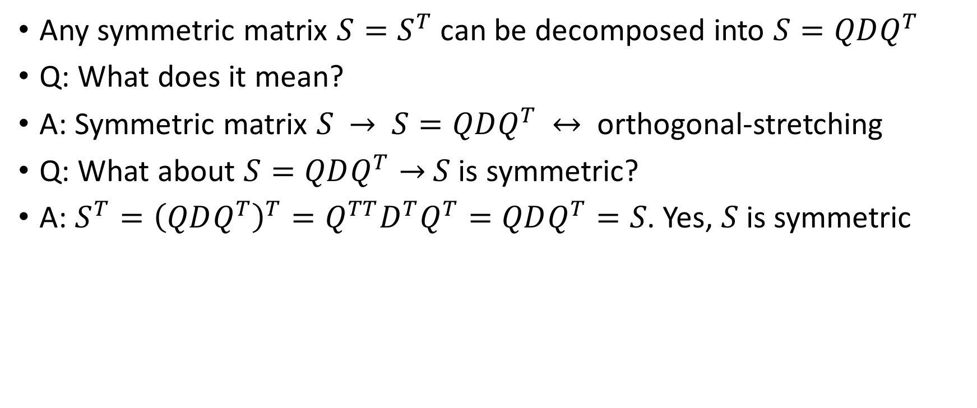
Spectral Theorem
Any symmetric matrix $S=S^{T}$ can be decomposed into $S=QDQ^{T}$
Q: What does it mean?
A: Symmetric matrix $S$ $→$ $S=QDQ^{T}$ $↔$ orthogonal-stretching
Q: What about $S=QDQ^{T}→$ $S$ is symmetric?
A: $S^{T}={\left(QDQ^{T}\right)}^{T}=Q^{TT}D^{T}Q^{T}=QDQ^{T}=S$. Yes, $S$is symmetric

Slide 20

Symmetric Matrix and Orthogonal Stretching
Symmetric matrix $↔$orthogonal-stretching transformation
  Considering reflection and projection as “stretching” with negative and 0 stretching factors, respectively
  Reflection: $\left(\begin{matrix}1 & 0 \\ 0 & −1\end{matrix}\right)$, Projection: $\left(\begin{matrix}1 & 0 \\ 0 & 0\end{matrix}\right)$

Slide 21
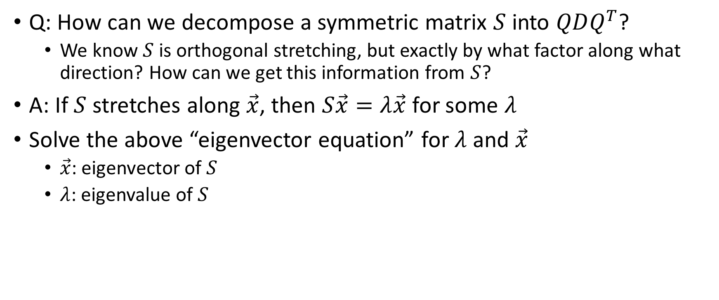
Symmetric Matrix: How Can We Decompose?
Q: How can we decompose a symmetric matrix $S$ into $QDQ^{T}$?
  We know $S$ is orthogonal stretching, but exactly by what factor along what direction? How can we get this information from $S$?
A: If $S$ stretches along $\vec{x}$, then $S\vec{x}=λ\vec{x}$ for some $λ$
Solve the above “eigenvector equation” for $λ$ and $\vec{x}$
  $\vec{x}$: eigenvector of $S$
  $λ$: eigenvalue of $S$

Slide 22
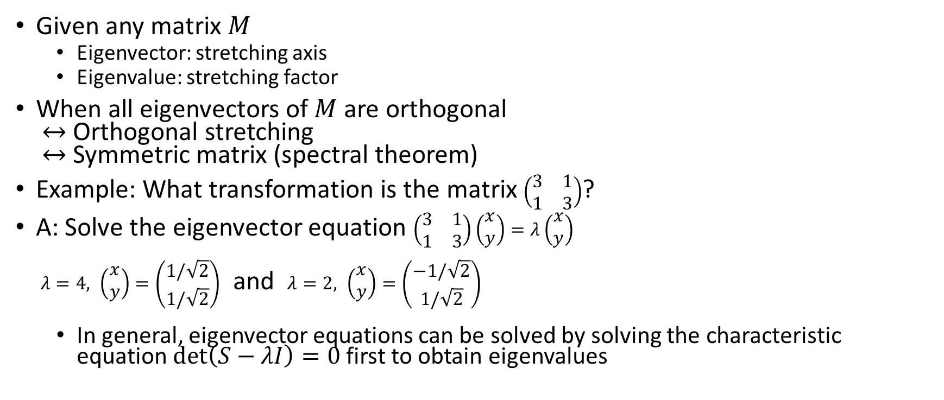
Eigenvalues, Eigenvectors and Orthogonal Stretching
Given any matrix $M$
  Eigenvector: stretching axis
  Eigenvalue: stretching factor
When all eigenvectors of $M$are orthogonal
$↔$ Orthogonal stretching
$↔$Symmetric matrix (spectral theorem)
Example: What transformation is the matrix $\left(\begin{matrix}3 & 1 \\ 1 & 3\end{matrix}\right)$?
A: Solve the eigenvector equation $\left(\begin{matrix}3 & 1 \\ 1 & 3\end{matrix}\right)\left(\begin{matrix}x \\ y\end{matrix}\right)=λ\left(\begin{matrix}x \\ y\end{matrix}\right)$
$λ=4, \left(\begin{matrix}x \\ y\end{matrix}\right)=\left(\begin{matrix}1/\sqrt{2} \\ 1/\sqrt{2}\end{matrix}\right)$ and $λ=2, \left(\begin{matrix}x \\ y\end{matrix}\right)=\left(\begin{matrix}−1/\sqrt{2} \\ 1/\sqrt{2}\end{matrix}\right)$
  In general, eigenvector equations can be solved by solving the characteristic equation $\det\left(S−λI\right)=0$ first to obtain eigenvalues

Slide 23
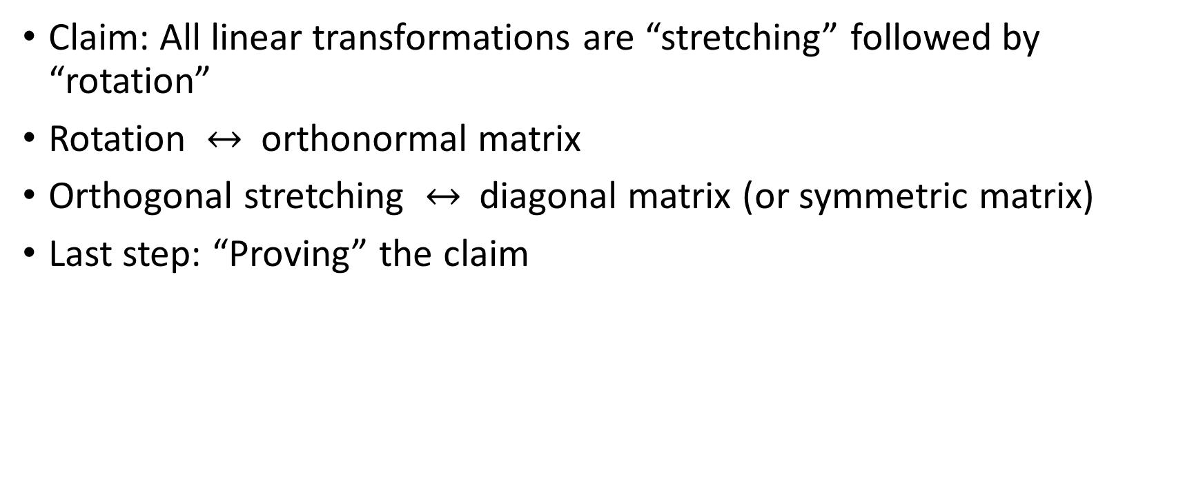
Where We Are
Claim: All linear transformations are “stretching” followed by “rotation”
Rotation $↔$ orthonormal matrix
Orthogonal stretching $↔$ diagonal matrix (or symmetric matrix)
Last step: “Proving” the claim

